Slide 1
Recurrent NNs
NLP - Section 7

Slide 2
RNNs
Recurrent means; occurring often or repeatedly.
The main idea is to overcome the “length” limitation.
Current LLMs now have the same problem of “length”
The main idea is to feed the sequential input to the same linear layer over and over.
We can stack these hidden layers to add complexity to the model.
Each layer can output y. This y can show us how each input changes the prediction of the model.
y can also represent prediction of the next x that the model will take.
(next-word prediction, sequential weather prediction)

Slide 3
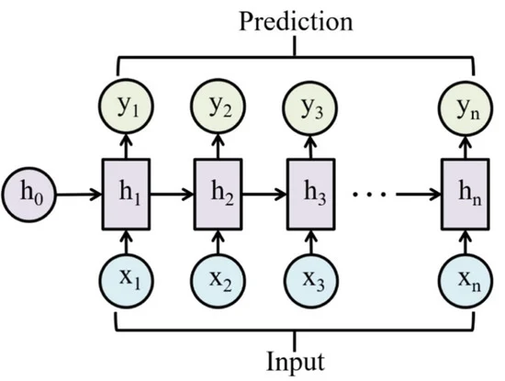
RNNs
h1, h2, h3 represent the hidden states.
y1 may represent a prediction for x2 or for the true label y.

Slide 4
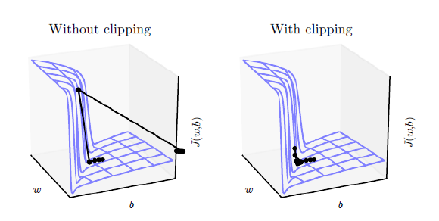
Exploding Gradients
If the sequence in the input during training is very large, the W multiplication is raised to the power of n where n is the sequence length
If n > 1 then we get exploding gradient where the gradient is too large which results in very big changes
A common solution to this problem
is clipping the gradient such that
the if the gradient is higher than a
certain threshold, it’s normalized.

Slide 5
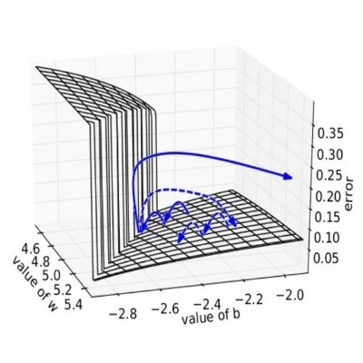
Vanishing Gradients
If the sequence in the input during training is very large, the W multiplication is raised to the power of n where n is the sequence length
If n < 1 then we get exploding gradient where the gradient is too small which results in no changes
Multiple solutions include
1- Good weight initialization
2- Batch Normalization
3- Not using RNN

Slide 6
Code
RNN demo
RNN in practice
Vanishing Gradients
Exploding Gradients

